Slide 1
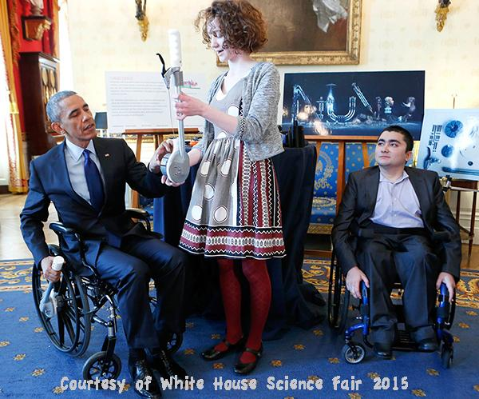
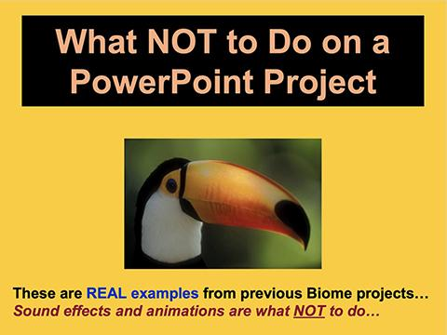
Criteria for Slides
Create in Google Slides, PowerPoint or Keynote
Presentation Time Limit – 6 minutes
Document Name for uploading must include Student Name
Maximum slide limit - 15 slides
“Pictures are better than words” - show clear photos of you working on your project
Photos must be by student or parents; other graphics must have credits
Explore the “What NOT to do in PPT” (Powerpoint) presentation before you create your presentation...

Slide 2
Digital Slides Formatting
Use the SLIDES with white backgrounds in this template as your Virtual Science Project Display for Judging
Follow the directions on each slide: type over the directions when you are ready.
Don’t change the slide titles (these will be the same for all students)
Title Fonts: 35pt, choice of style, color (must be readable!)
Body Font: Arial
Body Font size: Minimum = 18pt
Slide Backgrounds should not be busy – text must be easy to read
Slide animations and transitions should not be used as they cannot be replicated on a backboard.
Remove Criteria and Formatting Slides 1 and 2 for your final presentation.
Save this ppt with a your name: keep the original for directions

Slide 3
Science Project Replace text above with a Creative Title for your project
Sub-title (if necessary) Replace “sub-title” text above with a title that really explains what your project is about
Insert cool photo of your project or use a creative background that pertains to your project
Your name
Your teacher’s name
Your school

Slide 4
Abstract
Write the abstract last, after all your results and analysis are finished
The abstract is a summary (250 words or less) of your project and must include:
Problem
Procedures
Data and brief analysis (no graphs)
Conclusion (State whether and WHY your hypothesis or proposed solution was or was not validated).

Slide 5
Problem
This is the Problem Statement, written as a question - - What is the problem to be solved? You may add a graphic or photo to explain the problem.
According to the “ Science and Engineering PRACTICES": In Science, we refer to a question to be solved and written in the form of a question that includes both the independent and dependent variables.
Example: How does ___ (independent) ___ affect ___ (dependent) ___?
In Engineering, it is usually stated AS A PROBLEM: Examples:
Problem: Controlling hillside erosion in our city; or
Problem: Removing flood water from orange tree orchard; or
Problem: Removing litter from Alameda Bay sea floor.

Slide 6
Introduction (Background Research)
Brief summary of the background research needed to understand your problem.
For engineering, include the criteria/constraints necessary to solve your problem. Example: size, reusability, safety; time, money, materials that must or may not be used.
Include citations when referencing other scientists’ work.
Optional: an explanatory graphic, species photo, map of field research location, etc.

Slide 7
Hypothesis
For Science Projects, based on the research you have done, you will be writing an answer – your best educated guess – to your question.
One way to write a hypothesis:
"If _____[this is done] _____, then _____[this]_____ will happen." (Fill in the blanks with the appropriate information from your own project.)
Another way to write a hypothesis:
“I think ________________________ because ______________________________
For Engineering, Computer or Math projects; draw and label the solution/prototype model to the problem that you are going to test. Briefly explain WHY you chose this solution to test.

Slide 8
Materials
Type a bulleted list of the items you needed to complete your project.
Be specific about the amounts used.

Slide 9
Procedure
List and number all of the steps used in completing your project, including any retesting you did.
Draw and label a drawing/photo of any prototype or set-up that you used to test your solution.
Optional: Add photos (with captions) to show the steps of your procedures.
Up to 2 slides if absolutely necessary

Slide 10
Procedure (Continued)
OPTIONAL: 2nd slide if absolutely necessary

Slide 11
Results
Include any data you collected while testing your hypothesis or prototype.
If your testing procedures had repeated trials, make a data table AND/or graph(s) to show your results.
Add your written qualitative observations (color, smell, behavior, etc.) as well
For Engineering Projects, if you changed your solution/prototype after testing your original solution, then:
include any new data from the re-testing
also include labeled drawings of your REVISED solution/prototype and WHY you made those changes
Up to 2 slides if absolutely necessary

Slide 12
Results (Contin.)
OPTIONAL: 2nd slide if absolutely necessary

Slide 13
Discussion
Summarize and ANALYZE your data including trends, errors and variables that could have influenced the results.
Develop arguments for and against your hypothesis or solution/final prototype, using statistics (average, % error, a variety of statistical tests.)
Relate your findings to other studies and cite those studies.
(Up to 2 slides if absolutely necessary – OK to add graphics)

Slide 14
Discussion (Contin.)
OPTIONAL: 2nd slide if absolutely necessary

Slide 15
Conclusion
Type a brief summary here of what you discovered based on the results of your testing. You need to indicate whether or not the data supports your hypothesis or proposed solution and the reason for your conclusion. (no more than 250 words)

Slide 16
Reflection/Application
Things you might want to reflect on:
What did you learn from doing this project?
What you might have done differently?
What would be your next steps for researching this problem?
How can your results be applied in everyday life?
How could your results be applied to other studies?
Teams: what were the benefits/challenges of working as a team to find a solution?

Slide 17
References Cited
Be sure to include both print and electronic sources and put them in alphabetical order.
Use APA Citation formatting
Make sure your references match any citations in your Introduction or Discussion.
Jr Projects = Minimum 3 references
Sr Projects = Minimum 5 references

Slide 18
Designed by
Anne F. Maben
Science Consultant, UCLA Science Project
with feedback from the
Orange County and LA County
Science & Engineering Fairs
© 2020 All rights reserved
Remove this slide for your final presentation.

